Slide 1
View Techniques
Pipes
Asynchronous data
Forms
Custom pipes
Demo app: AngularDev/Demos/04-ViewTechniques/DemoApp
To install: npm install
To run: ng serve

Slide 2
Section 1: Pipes
Overview
Simple pipes
Simple pipes example
Additional pipes
Additional pipes examples

Slide 3
Overview
Pipes can format output in an HTML template
Examples of some simple built-in pipes in Angular:
There are 13 built-in pipes, as we'll see…
Each pipe is implemented as a class
For details, see https://angular.io/api/common#pipes
{{ expression | pipeName : param1 : param2 : ... paramN }}
{{ myfullname | uppercase }}
{{ mysalary | currency }}
{{ coffeetime | date : 'hh:mm:ss a' }}
3

Slide 4
Simple Pipes
Pipe name | Pipe class | Description
lowercase | LowerCasePipe | Transforms text to lower-case
uppercase | UpperCasePipe | Transforms text to upper-case
titlecase | TitleCasePipe | Transforms text to title-case
json | JsonPipe | Converts a JavaScript object into a JSON string
number | DecimalPipe | Formats number as text
percent | PercentPipe | Formats number as a percentage
currency | CurrencyPipe | Formats number as a currency
date | DatePipe | Formats a date as a string
keyvalue | KeyValuePipe | Transforms an object or a map into an array of key-value pairs
4

Slide 5
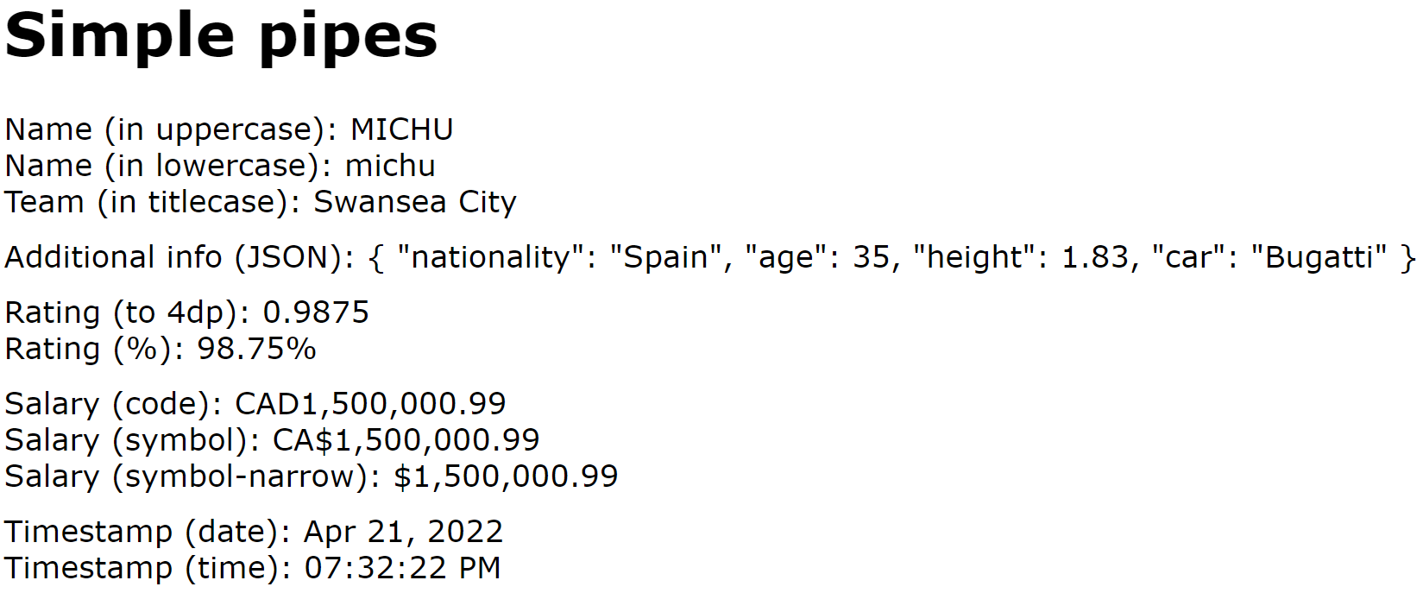
Simple Pipes Example
Let's see an example of simple pipes
In the demo app, click the Simple pipes link
See simple-pipes.component.html
5

Slide 6
Additional Pipes
Pipe name | Pipe class | Description
slice | SlicePipe | Creates a new List or String containing a subset (slice) of the elements
i18nPlural | I18nPluralPipe | Maps a numeric value into suitable plural string, e.g. 'mouse' or 'mice', 'child' or 'children', etc.
i18nSelect | I18nSelectPipe | Formats a string value into a suitably selected string, e.g. 'Dear Sir', 'Dear Madam', etc.
async | AsyncPipe | Accepts a Promise or Observable as input, and updates the view with the appropriate value(s) when the promise is resolved or the observable emits a new value.
6

Slide 7
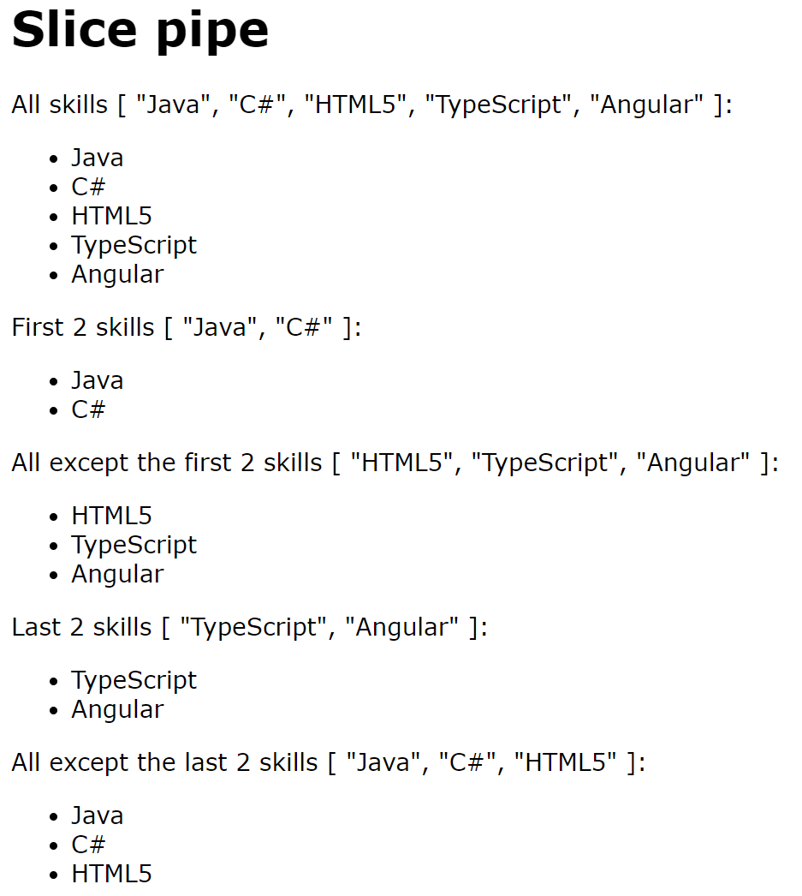
Additional Pipes Examples (1 of 3)
Let's first see an example of the slice pipe
In the demo, click Slice pipe
See slice-pipe.component.html
7

Slide 8
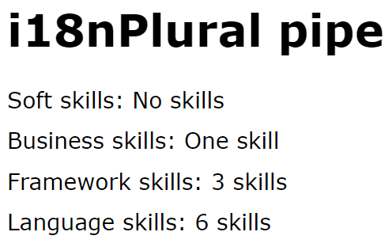
Additional Pipes Examples (2 of 3)
Now let's see an example of the i18nPlural pipe
In the demo, click i18nPlural pipe
See i18n-plural-pipe.component.html
8

Slide 9
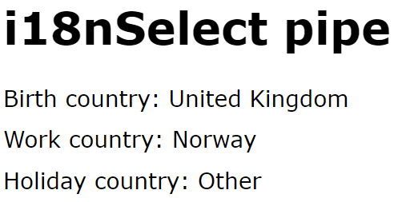
Additional Pipes Examples (3 of 3)
Now let's see an example of the i18nSelect pipe
In the demo, click i18nSelect pipe
See i18n-select-pipe.component.html
9

Slide 10
Section 2: Asynchronous Data
Overview
Promises
Observables
How to display asynchronous data
Asynchronous data example

Slide 11
Overview
Web apps often have to deal with asynchronous data
E.g. the result of a long calculation in a Web Worker
E.g. the result of a REST service
E.g. incoming data messages from a Web Socket
There are 2 ways to handle async data in a web app:
Promise - One-off asynchronous result
Observable - Stream of data from some source
11

Slide 12
Promises
Promise is a standard JavaScript class
Represents a one-off asynchronous result
The Promise constructor takes 1 argument - a callback function with two parameters (resolve, reject)
Do some async work in the callback, then call either resolve() or reject()
var aPromise = new Promise( (resolve, reject) => {
… … …
if (someTest)
resolve(someResult);
else
reject(someError);
});
12

Slide 13
Observables (1 of 2)
Observable is an RxJs (Reactive Ext^{n}s for JS) class
Represents an observable stream of data from a source
You need the rxjs dependency in package.json
Note, Angular CLI adds this automatically
"dependencies": {
"rxjs": "~7.5.0",
…
}
package.json
For details about the Observable class, see:
http://reactivex.io/rxjs/class/es6/Observable.js~Observable.html
13

Slide 14
Observables (2 of 2)
Observable example
interval()
Factory function, creates an Observable object that emits a sequential number every time interval
pipe()
Pipes the result into the map() operator function
import {interval} from 'rxjs';
import {map} from 'rxjs/operators';
let anObservable = interval(3000).pipe( map(() => new Date()) );
14

Slide 15
How to Display Asynchronous Data
If a component has an asynchronous data property, you can display it via the async pipe
What does the async pipe do?
Waits for a Promise object to be resolved
Subscribes to data published by an Observable object
{{ aPromise | async }}
{{ anObservable | async }}
15

Slide 16
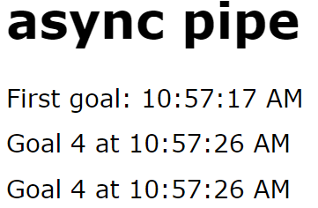
Asynchronous Data Example (1 of 3)
Let's see an example of asynchronous data
In the demo app, click the async pipe link
16

Slide 17
Asynchronous Data Example (2 of 3)
Here are the relevant bits of the TypeScript code
import {Observable, interval} from 'rxjs';
import {map} from 'rxjs/operators';
…
@Component(…)
export class AsyncPipeComponent {
firstGoal: Promise<Date>;
mostRecentGoal: Observable<Goal>;
constructor() {
this.firstGoal = new Promise((resolve, reject) => {
setTimeout(() => resolve(new Date()), 3000);
});
this.mostRecentGoal = interval(3000).
pipe(map(n => new Goal(n+1, new Date())));
}
}
async-pipe.component.ts
17

Slide 18
Asynchronous Data Example (3 of 3)
Here are the relevant bits of the HTML template
<div>
First goal:
{{ firstGoal | async | date:'hh:mm:ss a' }}
</div>
<div>
Goal {{ (mostRecentGoal | async)?.goalNumber }}
at {{ (mostRecentGoal | async)?.goalTimestamp | date:'hh:mm:ss a' }}
</div>
<div *ngIf='mostRecentGoal | async as mrg'>
Goal {{ mrg.goalNumber }}
at {{ mrg.goalTimestamp | date:'hh:mm:ss a' }}
</div>
async-pipe.component.html
18

Slide 19
Section 3: Forms
Strategies for implementing forms
Adding support for forms
Examples

Slide 20
Strategies for Implementing Forms
Template-driven forms
The HTML template specifies form semantics
Reactive forms (a.k.a. model-driven forms)
The component class defines form semantics in code
20

Slide 21
Adding Support for Forms
Your app dependencies must include Angular Forms
Your app module must bundle either FormsModule or ReactiveFormsModule
"dependencies": {
"@angular/forms": "~14.1.0",
…
}
package.json
import { FormsModule --or-- ReactiveFormsModule } from '@angular/forms';
…
@NgModule({
imports: [FormsModule --or-- ReactiveFormsModule, …],
…
})
export class AppModule {}
app.module.ts
21

Slide 22
Examples
The demo app has examples of the forms strategies…
Click the appropriate link in the demo app:
Template-driven forms
Reactive forms
22

Slide 23
Summary
Pipes
Asynchronous data
Forms

Slide 24
Annex: Custom Pipes
Overview
Generating a custom pipe
Implementing a custom pipe
Bundling a custom pipe
Using a custom pipe
Running the demo application

Slide 25
Overview
You can define custom pipes
Define a class and decorate with @Pipe
Implement the PipeTransform interface
import {Pipe, PipeTransform} from '@angular/core';
…
@Pipe({name: 'nameOfMyPipe'})
class MyPipeClass implements PipeTransform {
transform(value: any, ...args: any[]): string {
// Add code here, to transform the value and return the result.
…
}
}
25

Slide 26
Generating a Custom Pipe
You can use Angular CLI to generate a custom pipe
For example, this is how we generated a custom pipe in the demo application:
ng g pipe custom-pipes
26

Slide 27
Implementing a Custom Pipe
Here's the implementation of our custom pipe class:
@Pipe({name: 'flexititlecase'})
export class FlexiTitleCasePipe implements PipeTransform {
transform(value: string, upperOrLower: string): string {
if (upperOrLower !== 'upper' && upperOrLower !== 'lower')
return value;
let words:string[] = value.split(' ');
for (var i = 0; i < words.length; i++)
if (upperOrLower === 'upper')
words[i] = words[i].charAt(0).toUpperCase() +
words[i].slice(1).toLowerCase();
else
words[i] = words[i].charAt(0).toLowerCase() +
words[i].slice(1).toUpperCase();
return words.join(' ');
}
}
flexi-title-case.pipe.ts
27

Slide 28
Bundling a Custom Pipe
You must bundle custom pipes into your app module
Angular CLI does this for you automatically
import { FlexiTitleCasePipe } from './flexi-title-case.pipe';
…
@NgModule({
declarations: [FlexiTitleCasePipe, … ],
imports: [BrowserModule, AppRoutingModule],
providers: [],
bootstrap: [AppComponent]
})
export class AppModule { }
app.module.ts
28

Slide 29
Using a Custom Pipe
You can use the custom pipe in the HTML template for a component, as follows:
<h1>Custom pipes</h1>
<div>
Name: {{ name }}
</div>
<div>
Name (flexititlecase:'upper'): {{ name | flexititlecase:'upper' }}
</div>
<div>
Name (flexititlecase:'lower'): {{ name | flexititlecase:'lower' }}
</div>
custom-pipes.component.html
29

Slide 30
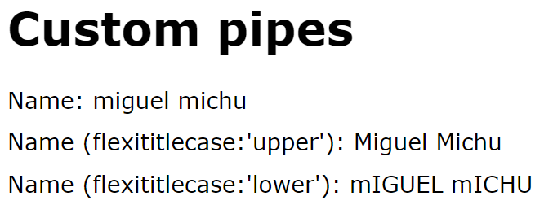
Running the Demo Application
Let's see the custom pipe in action
In the demo app, click the Custom pipes link
30

